Slide 1


Engineering Economics| ME 2001 | 3 Credits | 3 0 0 3
Lecture 5
Cost Analysis

Slide 2
ELEMENTS OF COSTS
Lecture 5
Cost can be broadly classified into variable cost and overhead cost. Variable cost varies with the volume of production while overhead cost is fixed, irrespective of the production volume.
Variable cost can be further classified into direct material cost, direct labour cost, and direct expenses.
The overhead cost can be classified into factory overhead, administration overhead, selling overhead, and distribution overhead.
The selling price of a product is derived as shown below:
(a) Direct material costs + Direct labour costs + Direct expenses = Prime cost
(b) Prime cost + Factory overhead = Factory cost
(c) Factory cost + Office and administrative overhead = Costs of production
(d) Cost of production + Opening finished stock – Closing finished stock = Cost of goods sold
(e) Cost of goods sold + Selling and distribution overhead = Cost of sales
(f) Cost of sales + Profit = Sales
(g) Sales/Quantity sold = Selling price per unit

Slide 3
OTHER COSTS/REVENUES
Lecture 4
Marginal Cost
Marginal cost of a product is the cost of producing an additional unit of that product. Let the cost of producing 20 units of a product be Rs. 10,000 and the cost of producing 21 units of the same product be Rs. 10,045. Then the marginal cost of producing the 21st unit is Rs. 45.
Marginal Revenue
Marginal revenue of a product is the incremental revenue of selling an additional unit of that product. Let, the revenue of selling 20 units of a product be Rs. 15,000 and the revenue of selling 21 units of the same product be Rs. 15,085. Then, the marginal revenue of selling the 21st unit is Rs. 85.
Sunk Cost
This is known as the past cost of an equipment/asset. Let us assume that an equipment has been purchased for Rs. 1,00,000 about three years back. If it is considered for replacement, then its present value is not Rs. 1,00,000. Instead, its present market value should be taken as the present value of the equipment for further analysis. So, the purchase value of the equipment in the past is known as its sunk cost. The sunk cost should not be considered for any analysis done from now onwards.

Slide 4
Opportunity Cost
Lecture 4
In practice, if an alternative (X) is selected from a set of competing alternatives (X,Y), then the corresponding investment in the selected alternative is not available for any other purpose. If the same money is invested in some other alternative (Y), it may fetch some return. Since the money is invested in the selected alternative (X), one has to forego the return from the other alternative (Y). The amount that is foregone by not investing in the other alternative (Y) is known as the opportunity cost of the selected alternative (X). So the opportunity cost of an alternative is the return that will be foregone by not investing the same money in another alternative.
Invested in a fixed deposit, a bank will pay a return of 18%. Then, the corresponding total return per year for the investment in the bank is Rs. 9,000. This return is greater than the return from shares. The foregone excess return of Rs. 1,500 by way of not investing in the bank is the opportunity cost of investing in shares.

Slide 5
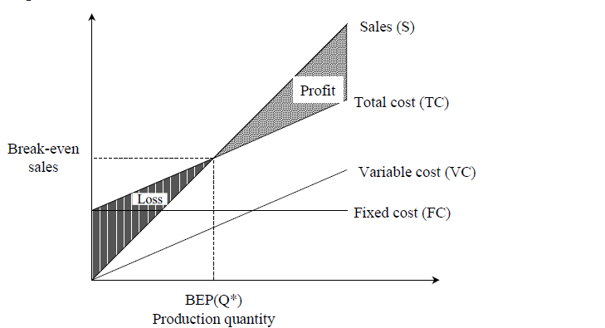
BREAK-EVEN ANALYSIS
Lecture 5
This point is also called the no-loss or no-gain
situation. For any production quantity which is less than the break-even quantity, the total cost is more than the total revenue. Hence, the firm will be making loss.
For any production quantity which is more than the break-even quantity, the total revenue will be more than the total cost. Hence, the firm will be making profit.

Slide 6
s = selling price per unit
v = variable cost per unit
FC = fixed cost per period
Q = volume of production
The total sales revenue (S) of the firm is given by the following formula:
S = s Q
The total cost of the firm for a given production volume is given as
TC = Total variable cost + Fixed cost = v Q + FC
Profit = Sales – (Fixed cost + Variable costs)
= s Q – (FC + v Q)
Break-even quantity = Fixed cost/Selling price/unit - Variable cost/unit
=FC/s-v (in units)
Break-even sales
= {Fixed cost/Selling price/unit - Variable cost/unit }* Selling price/unit
= {FC/s-v }*s (Rs)
Contribution = Sales – Variable costs
Contribution/unit = Selling price/unit – Variable cost/unit
M.S. = Actual sales – Break-even sales
= {Profit/Contribution}*sales
M.S. as a per cent of sales = (M.S./Sales)*100

Slide 7
Problem No: 1
Alpha Associates has the following details:
Fixed cost = Rs. 20,00,000
Variable cost per unit = Rs. 100
Selling price per unit = Rs. 200
Find
(a) The break-even sales quantity,
(b) The break-even sales
(c) If the actual production quantity is 60,000, find (i) contribution; and
(ii) margin of safety by all methods.

Slide 8
Solution
Fixed cost (FC) = Rs. 20,00,000
Variable cost per unit (v) = Rs. 100
Selling price per unit (s) = Rs. 200
(a) Break-even quantity = FC/s-v
= 20,00,000/100 = 20,000 units
(b) Break-even sales = [FC/s-v] *s (Rs.)
= 20 00 000/100 * 200
= Rs. 40,00,000
(c) (i) Contribution = Sales – Variable cost
= s *Q – v *Q
= 200 *60,000 – 100 *60,000
= 1,20,00,000 – 60,00,000
= Rs. 60,00,000
(ii) Margin of safety
METHOD I
M.S. = Sales – Break-even sales
= 60,000 *200 – 40,00,000
= 1,20,00,000 – 40,00,000 = Rs. 80,00,000
METHOD II
M.S. = Profit/Contribution * Sales
Profit = Sales – (FC + v Q)
= 60,000 *200 – (20,00,000 + 100 * 60,000)
= 1,20,00,000 – 80,00,000 = Rs. 40,00,000
M.S. =40,00,000/60,00,000 *1,20,00,000
= Rs. 80,00,000
M.S. as a per cent of sales = (M.S./Sales)*100
= 80,00,000/ 1,20,00,000 *100
= 67%

Slide 9
PROFIT/VOLUME RATIO (P/V RATIO)
P/V ratio is a valid ratio which is useful for further analysis. P/V ratio = Contribution/Sales
= Sales - Variable costs/ Sales
The relationship between BEP and P/V ratio is as follows:
BEP = Fixed cost/(P/V ratio)
The following formula helps us find the M.S. using the P/V ratio:
M.S. = Profit / (P/V ratio)

Slide 10
Problem No: 2
Consider the following data of a company for the year 1997:
(i) Sales = Rs. 1,20,000
(ii) Fixed cost = Rs. 25,000
(iii) Variable cost = Rs. 45,000
Find the following:
(a) Contribution
(b) Profit
(c) BEP
(d) M.S.

Slide 11
Solution
Given:
(i) Sales = Rs. 1,20,000
(ii) Fixed cost = Rs. 25,000
(iii) Variable cost = Rs. 45,000
(a) Contribution = Sales – Variable costs
= Rs. 1,20,000 – Rs. 45,000
= Rs. 75,000
(b) Profit = Contribution – Fixed cost
= Rs. 75,000 – Rs. 25,000
= Rs. 50,000
(c) BEP
P/V ratio = Contribution / Sales
= 75,000/1,20,000 = 62.50%
BEP = Fixed cost/ (P/V ratio)
= 25000/62.50* 100
= Rs. 40,000
M.S. = Profit/P/V ratio
= 50 000/62 50 * 100
= Rs. 80,000

Slide 12
Problem No: 3
Consider the following data of a company for the year 1998:
(i) Sales = Rs. 80,000
(ii) Fixed cost = Rs. 15,000
(iii) Variable cost = 35,000
Find the following:
(a) Contribution
(b) Profit
(c) BEP
(d) M.S.

Slide 13
Solution
Given:
(i) Sales = Rs. 80,000
(ii) Fixed cost = Rs. 15,000
(iii) Variable cost = Rs. 35,000
(a) Contribution = Sales – Variable costs
= Rs. 80,000 – Rs. 35,000
= Rs. 45,000
(b) Profit = Contribution – Fixed cost
= Rs. 45,000 – Rs. 15,000
= Rs. 30,000
(c) BEP
P/V ratio = Contribution / Sales
= 45,000/80,000
= 56.25%
BEP = Fixed cost/ (P/V ratio)
= 15000/56.25* 100
= Rs. 26,667
M.S. = Profit/(P/V ratio)
= 30 000/56.25 * 100
= Rs. 53,333.33

